Slide 1

British Airways Customer Bookings Classification Model
By: Rakim Reid
July 2, 2023

Slide 2
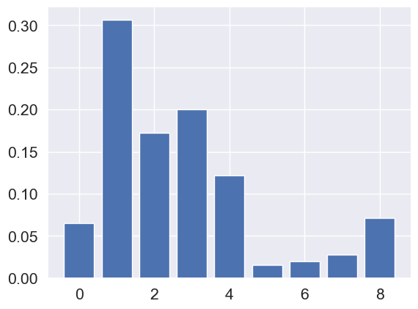
Customer bookings are strongly influenced by travel plans.
85% model accuracy
Random Forest was used to classify whether if a potential customer completed a booking. Interestingly, the most relevant features had more to do with travel plans and when the booking was made than the flight experience. Travel plans may strongly whether someone books a ticket or not.
Relevant Features
purchase_lead: 0.306552
length_of_stay: 0.171979
flight_hour: 0.199712
4) flight_day: 0.122072
----------------------------------------
0) num_passengers: 0.065123
5) wants_extra_baggage: 0.015622
6) wants_preferred_seat: 0.019784
7) wants_in_flight_meals: 0.027574
8) flight_duration: 0.071582

